Slide 1
Children Without Placement
Update to the Children’s Commission
May 17, 2024

Slide 2
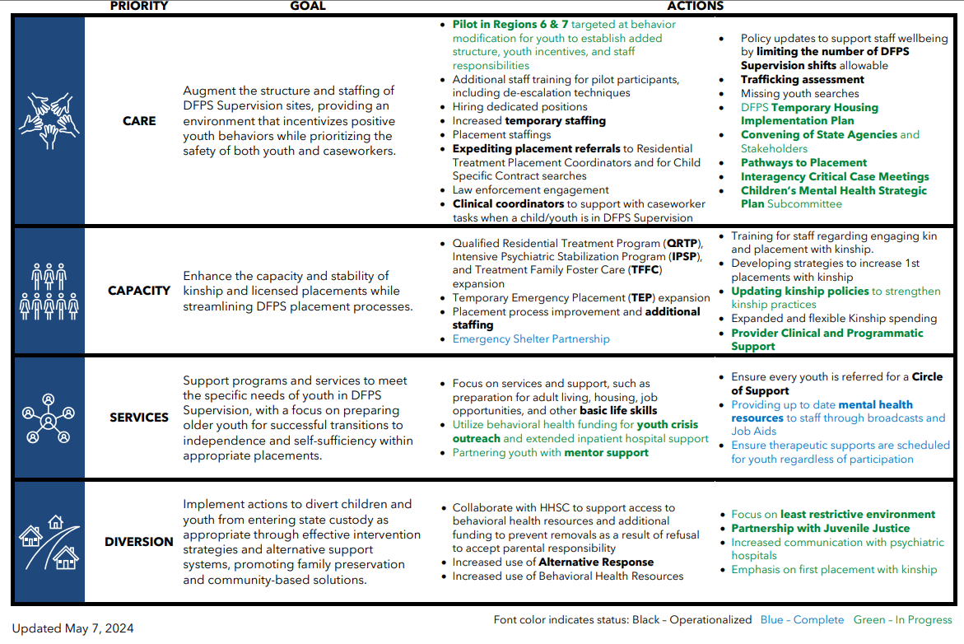
Children Without Placement Agency Efforts
2

Slide 3
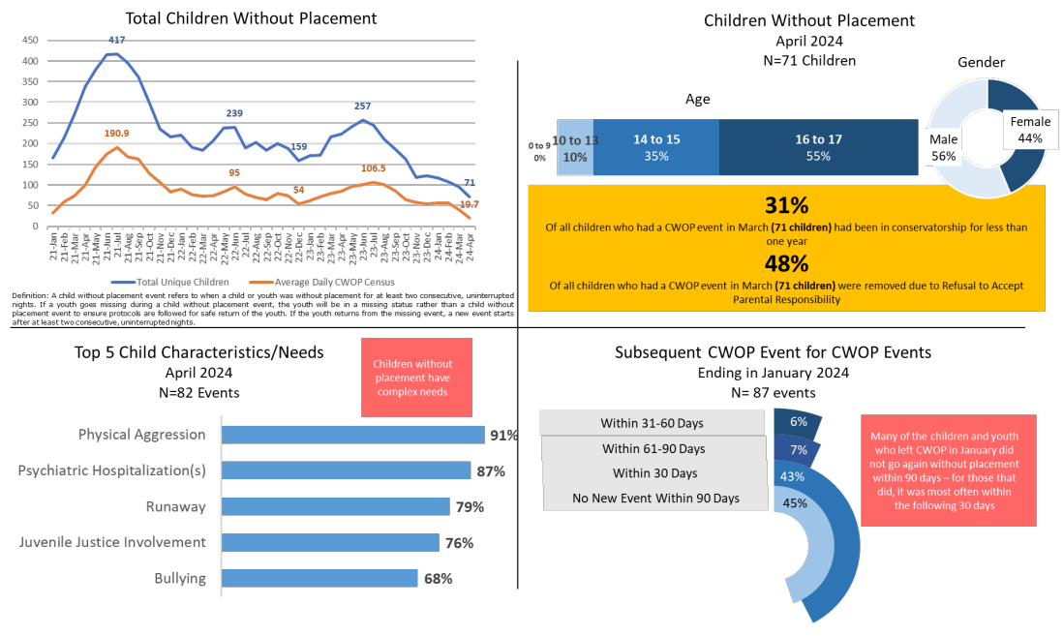
Children Without Placement - Data
3

Slide 4
DFPS Census of Children in Care
Of the 16,372 children in care (ages 0-17) at the end of April 2024 Statewide:
10,043/ 61.3%
were in foster care
6,329/ 38.7%
were in other types of substitute care
7,263/ 44.4%
Child Placing Agency
Foster Homes
1,110/ 6.8% Residential Treatment Centers
5,747/ 35.1%
Kinship Care (unverified)
356/ 2.2%
Independent Living and Other
190/ 1.2%
DFPS Foster Homes
832/ 5.1%
GRO
Childcare Only
196/ 1.2%
CPA Adoptive Homes
22/ 0.1% Children without Placement
357/ 2.2%
Emergency Shelters
30/ 0.2%
DFPS Adoptive Homes
269/ 1.6%
Other Foster Care
Data Source: CAPS Sub/Adopt Data Warehouse SA_05s, Warehouse Data As of: 05/07/24
Report Run Date: 05/13/2024
4

Slide 5
Children Without Placement – Progress Data
Source: CWOP Tracker, Data as of 5/13/2024
Drivers of success:
Strategic system wide efforts
Individual child intensive focus
Interagency collaboration
Children and youth in conservatorship continue to have very high needs that remain even after placement, and create risk for placement disruption.
5

Slide 6
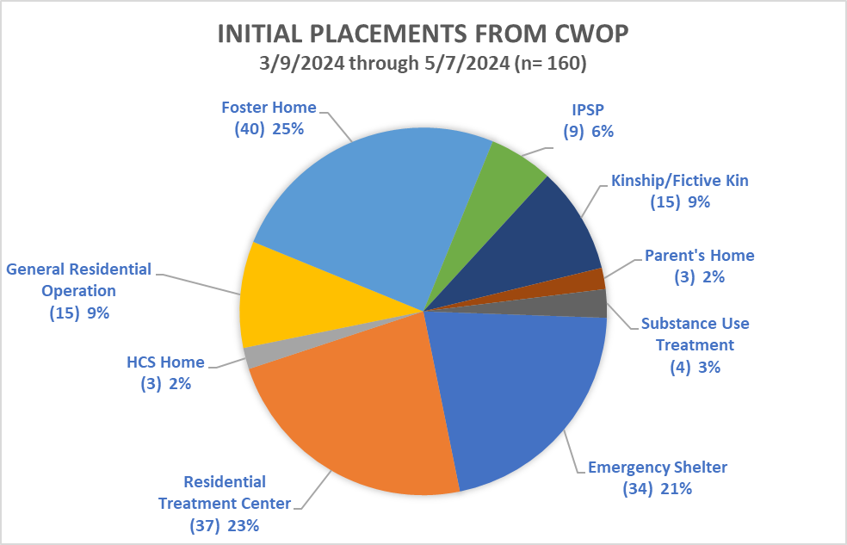
Children Without Placement – Initial Placement Data
6
Source: DFPS Analysis as of 5/7/2024

Slide 7
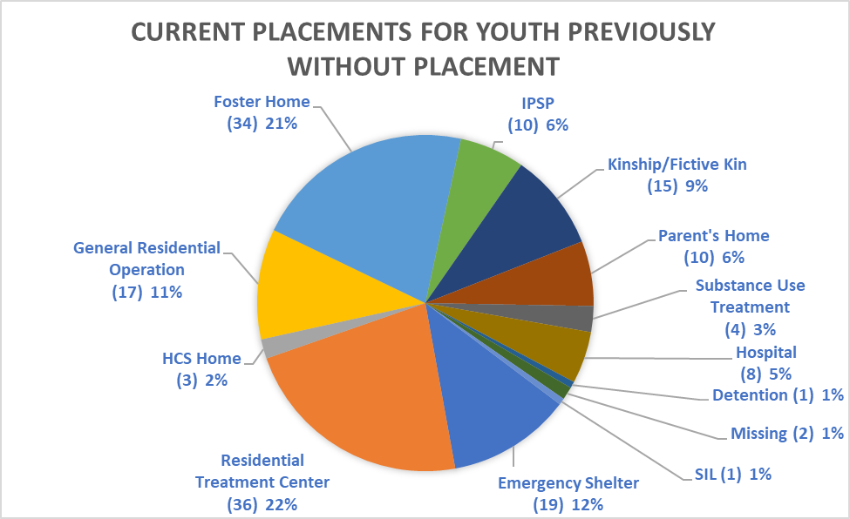
Children Without Placement – Current Placement Data
7
Source: DFPS Analysis as of 5/7/2024

Slide 8
Children Without Placement
Drivers of Success
Strategic System Wide Efforts
By collaborating with internal subject matter experts to understand barriers and limitations, DFPS has improved system concerns by centralizing functions essential to finding placement solutions, surveying providers to understand limits to capacity expansion, developed a community resource guide to help families in need of behavioral health support, and received funding to expand monitoring to more youth in Texas.
Individual Child Intensive Focus
This initiative involves an intensive daily meeting process that fosters accountability and commitment among all participants to ensure the safety and well-being of youth.
Interagency Collaboration
Convening representatives from relevant state agencies and partners use collective resources, knowledge, and expertise to understand state gaps. The anticipated outcomes are a reduced number of children and youth in unlicensed placements; enhanced safety, stability, and well-being of affected children; and improved collaboration and communication among state and partnering agencies.

Slide 9
Children Without Placement
Barriers
Changing landscape of behavioral and mental health needs of youth
Limitations on availability of certain types of placements for youth with high needs

Slide 10
Thank You
Audrey O’Neill
Deputy Commissioner of Programs
audrey.oneill2@dfps.texas.gov
Deb Malone- Renelt
Director of Placement Services
debra.malonerenelt@dfps.texas.gov

